Slide 1
Can I believe this paper?
Tools for the detection and correction of biases in the scientific literature
Miguel A. Vadillo

Slide 2
What’s wrong with science?

Slide 3
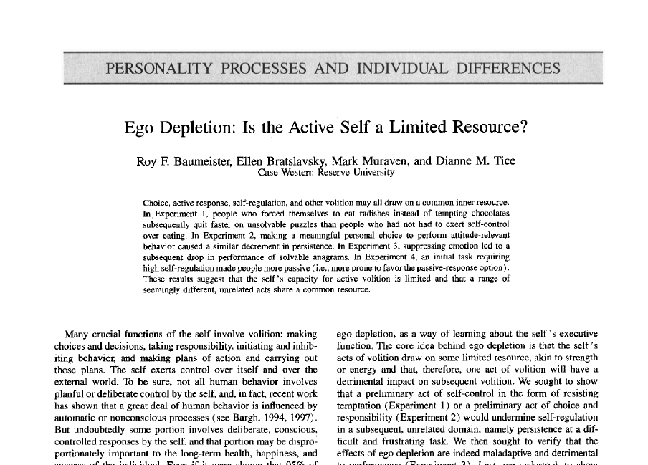

Slide 4
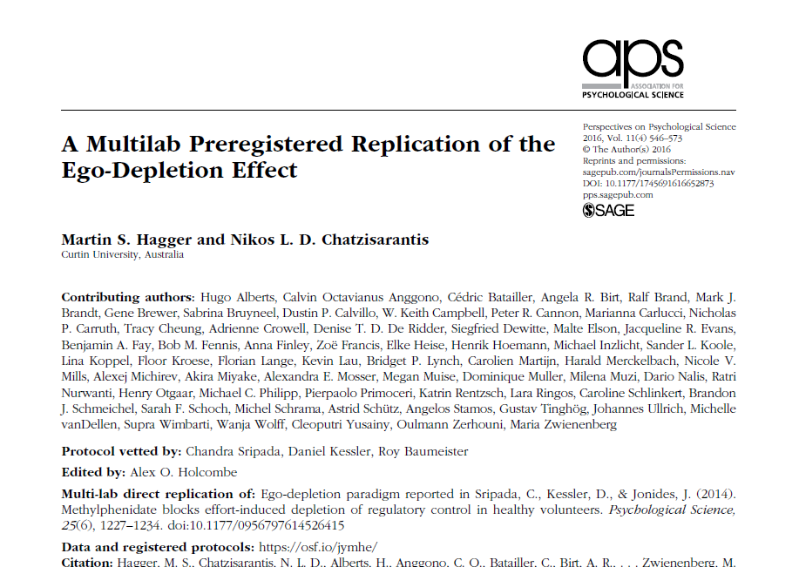
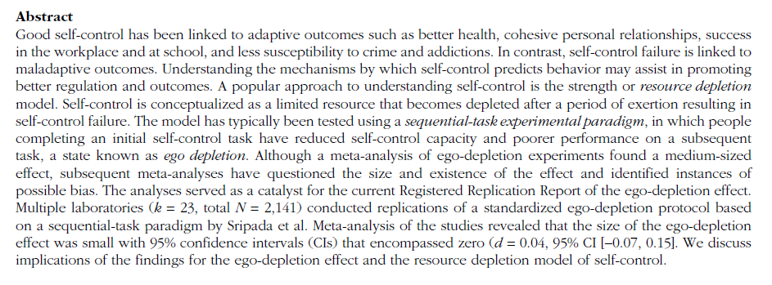

Slide 5
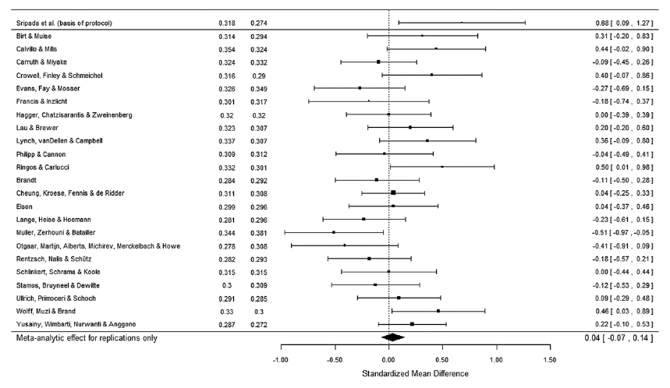

Slide 6
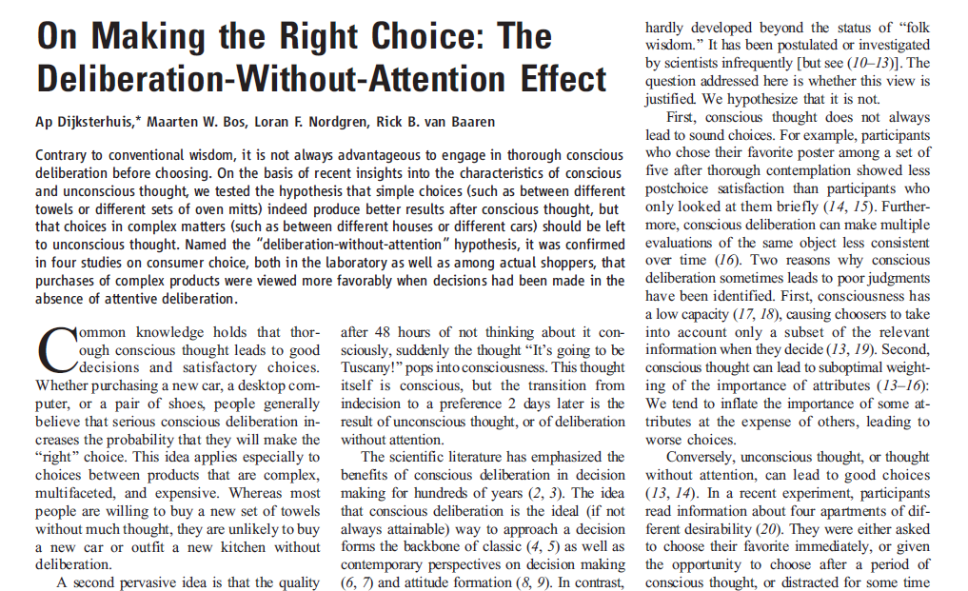

Slide 7
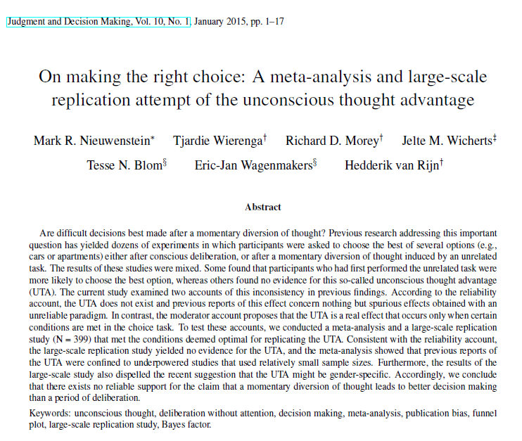

Slide 8
Most research findings are false

Slide 9
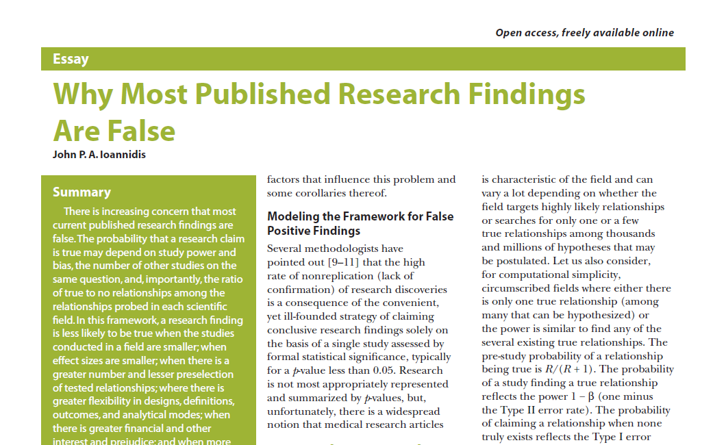

Slide 10
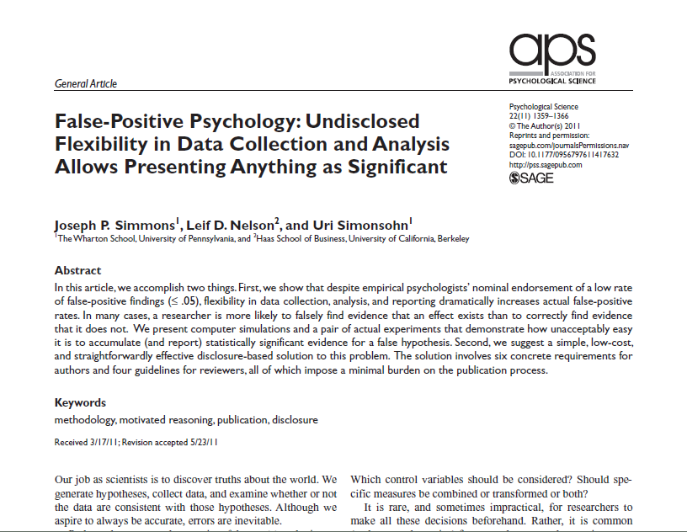
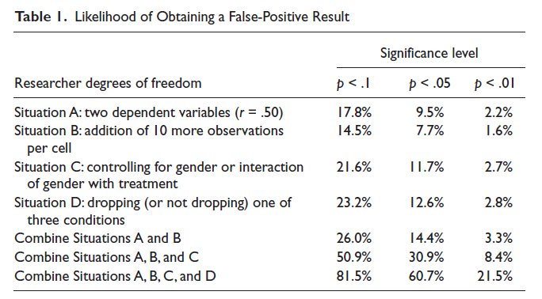

Slide 11
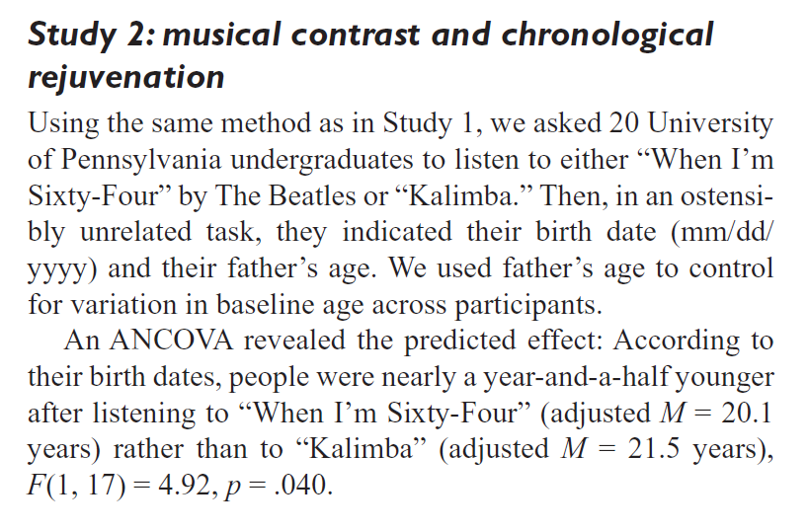

Slide 12
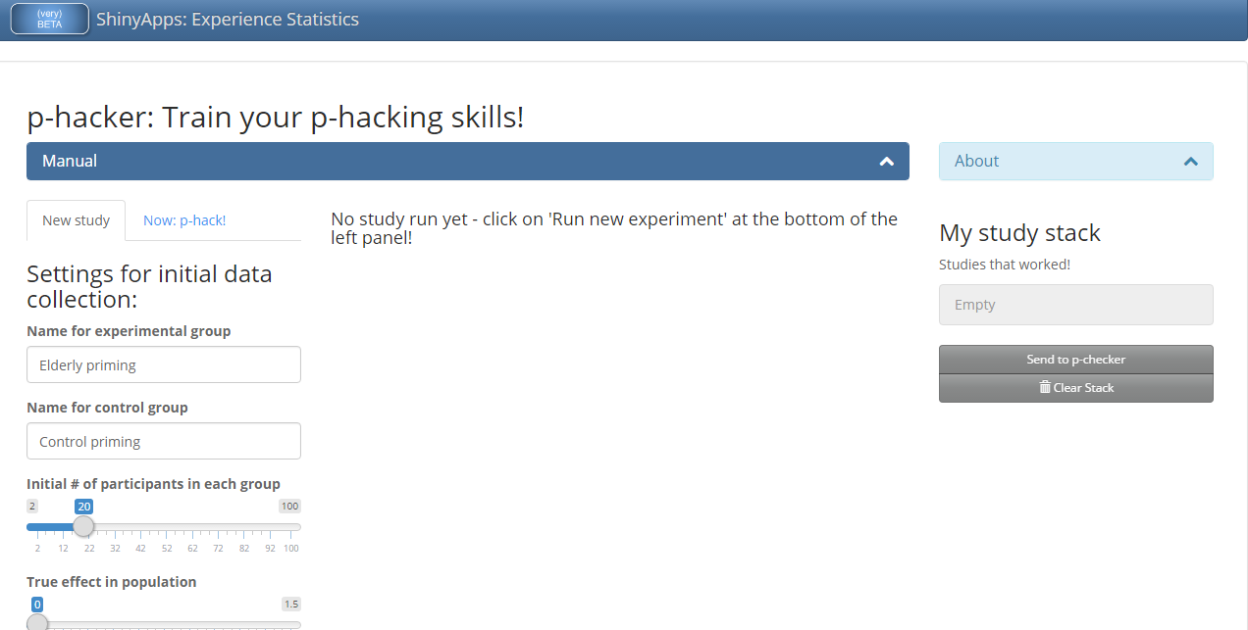
p-hacking is so easy…
Do it yourself at p-hacker http://shinyapps.org/apps/p-hacker/

Slide 13
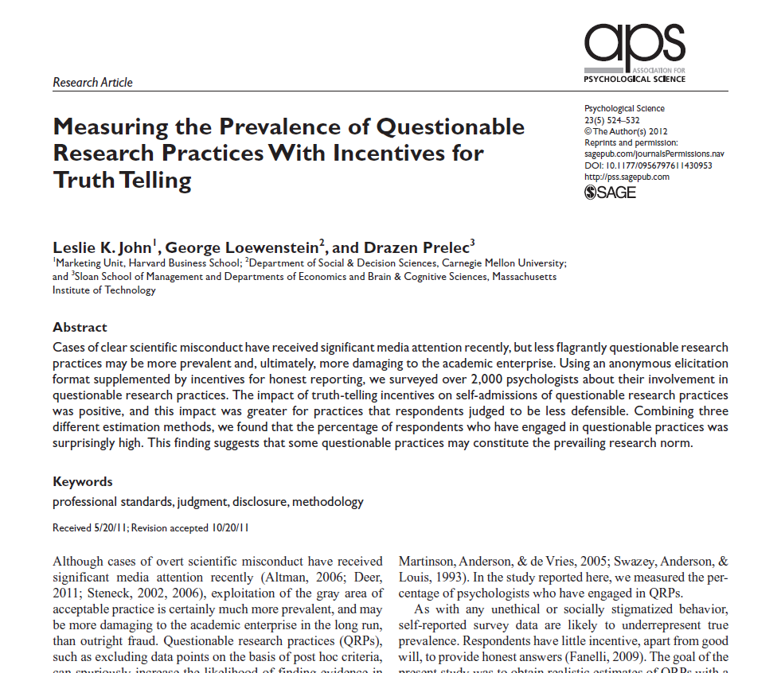
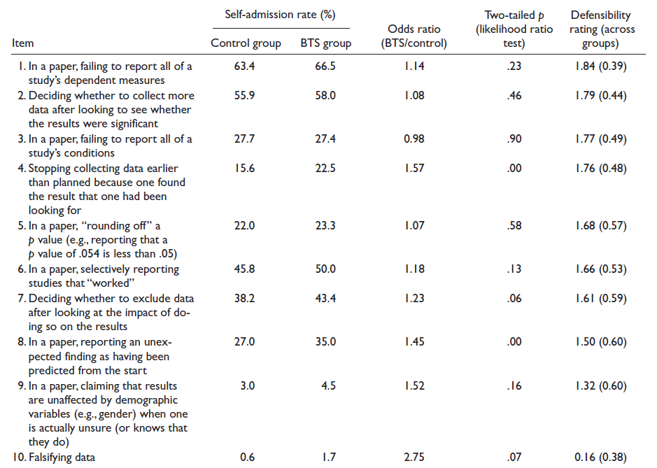

Slide 14
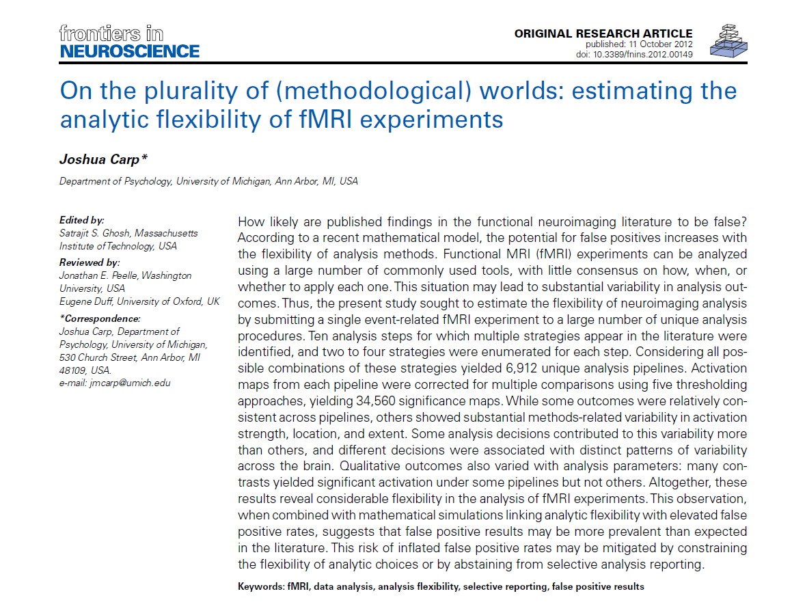

Slide 15
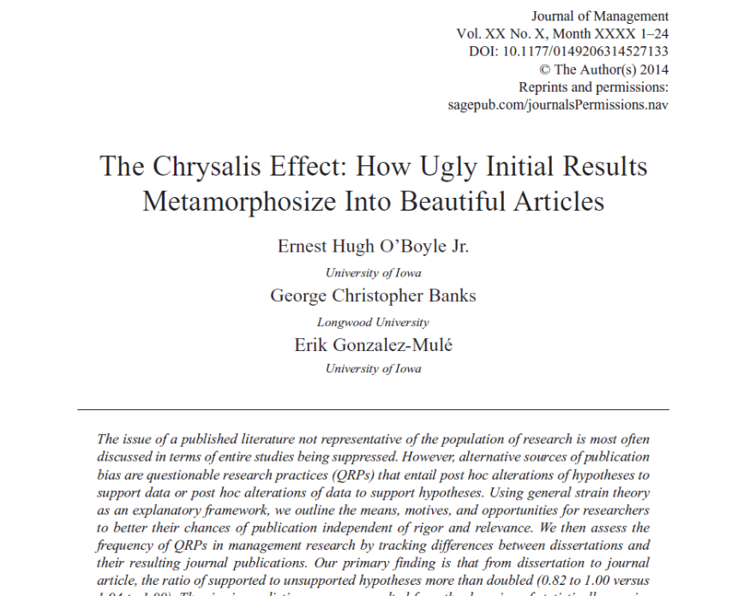
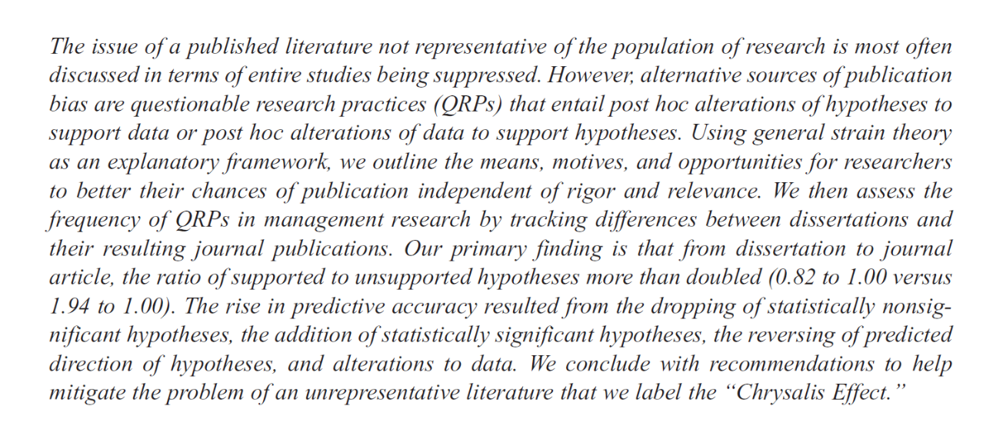

Slide 16
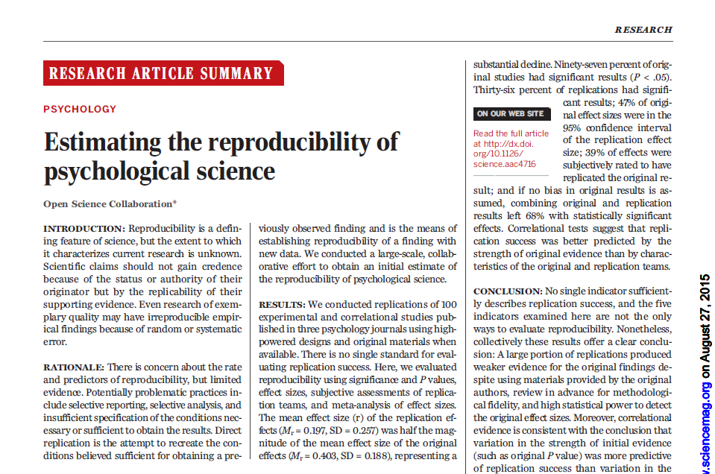
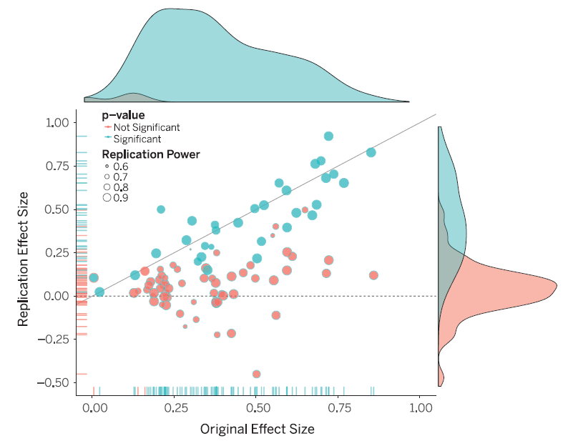

Slide 17
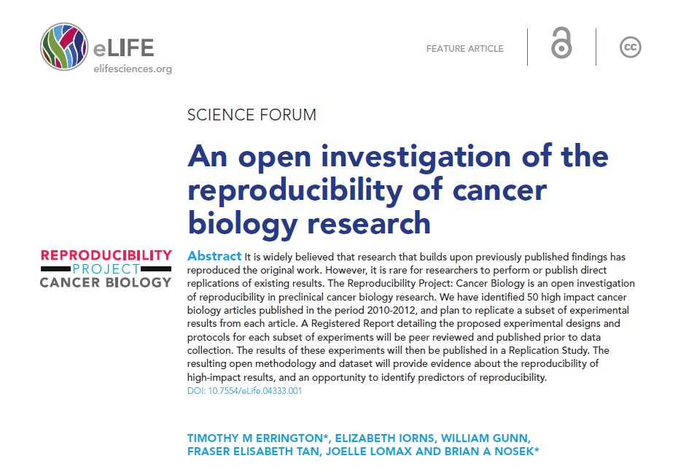

Slide 18
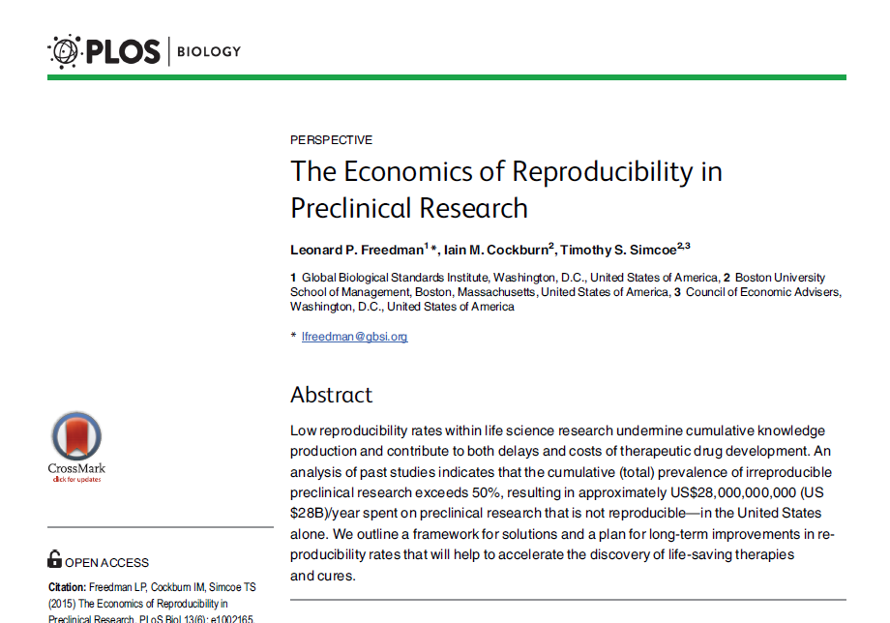

Slide 19
Methods to detect biases in research
#1. p-curve analysis

Slide 20
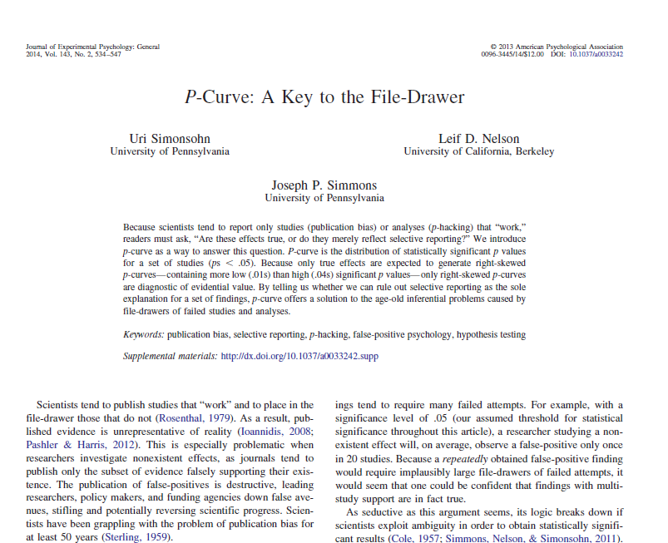

Slide 21
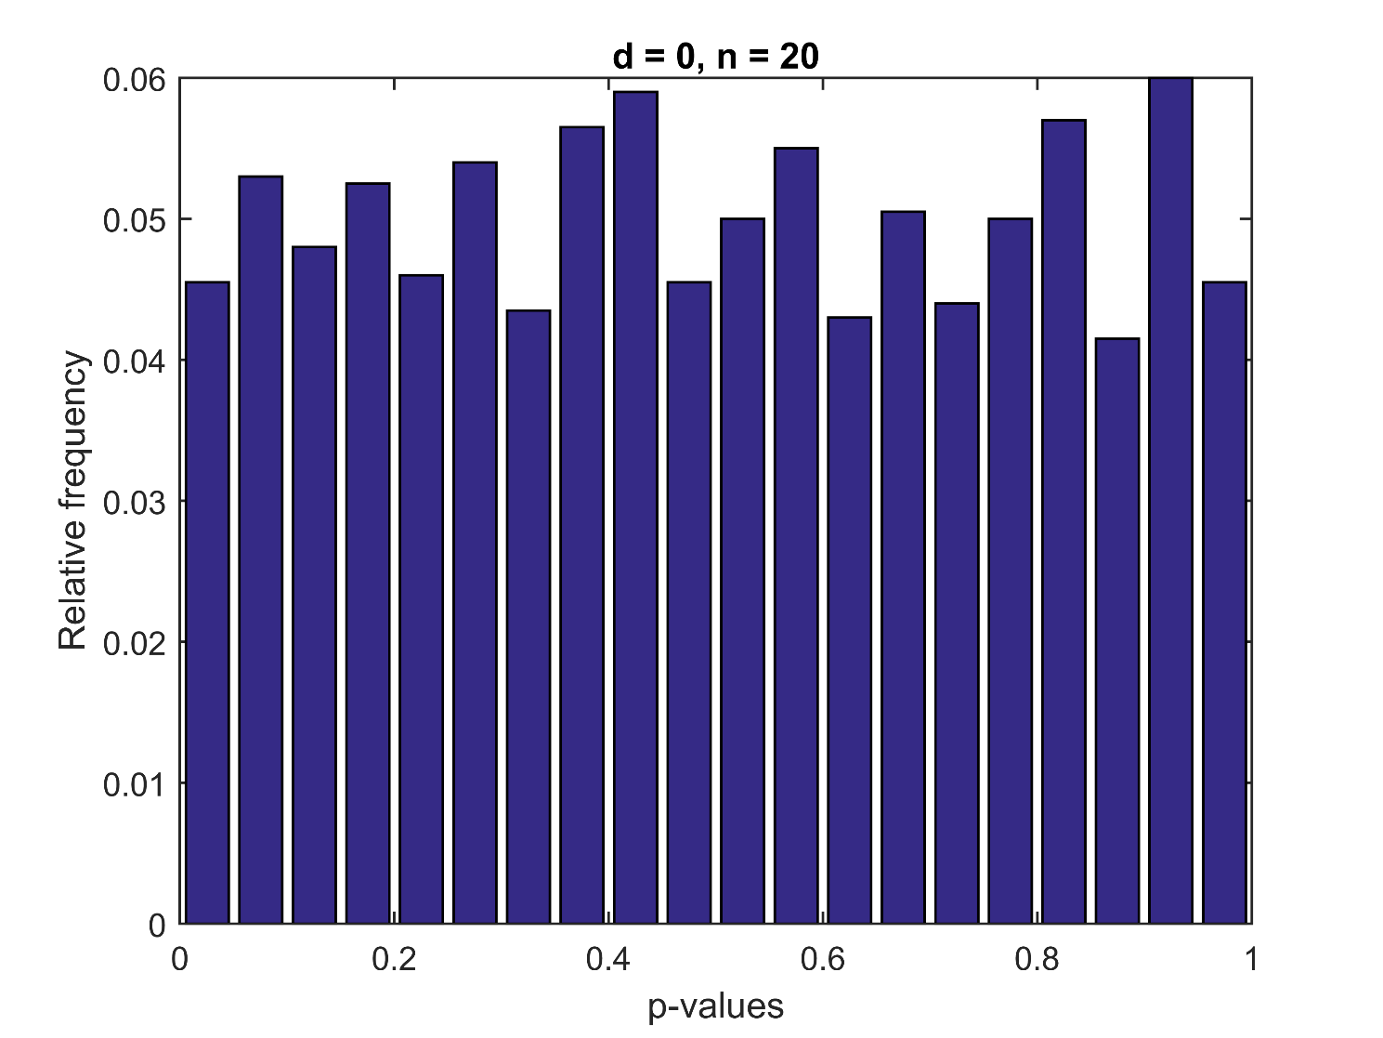
If you repeat an experiment many times but the true effect is zero, the distribution of p-values is flat.

Slide 22
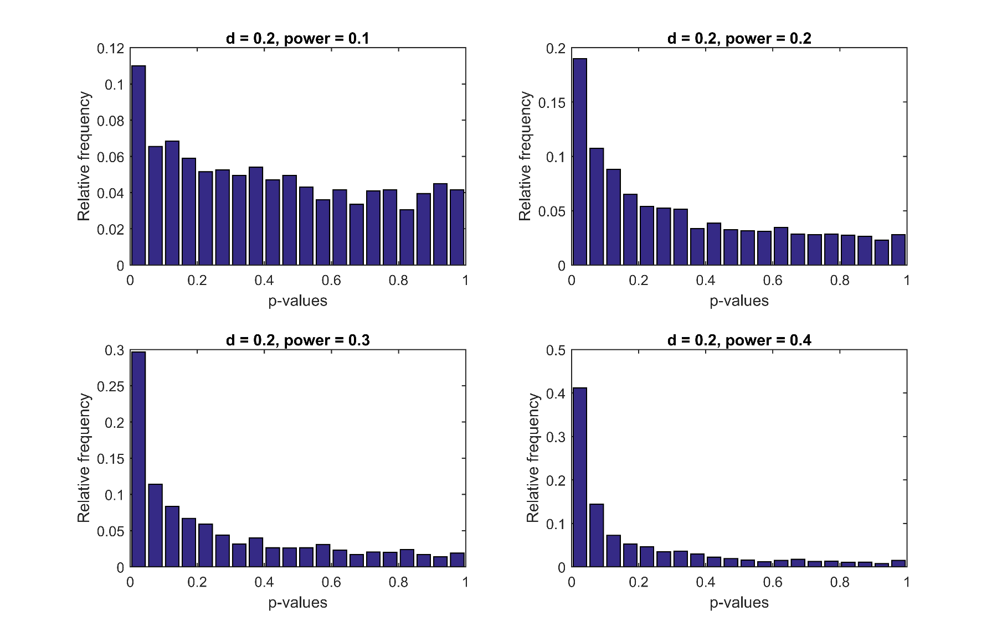
If the true effect is nonzero, the distribution is right-skewed. The slope depends on statistical power.

Slide 23
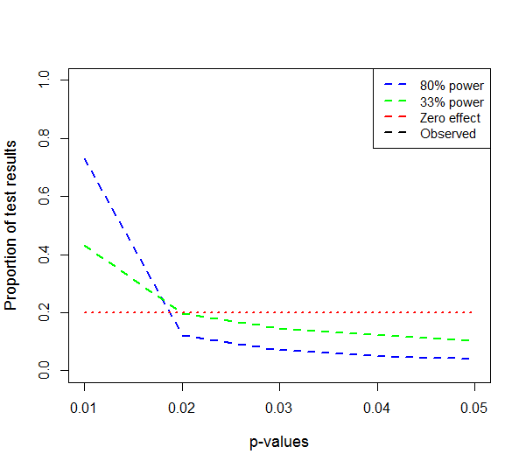
This applies also within the subset of statistically significant results.

Slide 24
An example

Slide 25
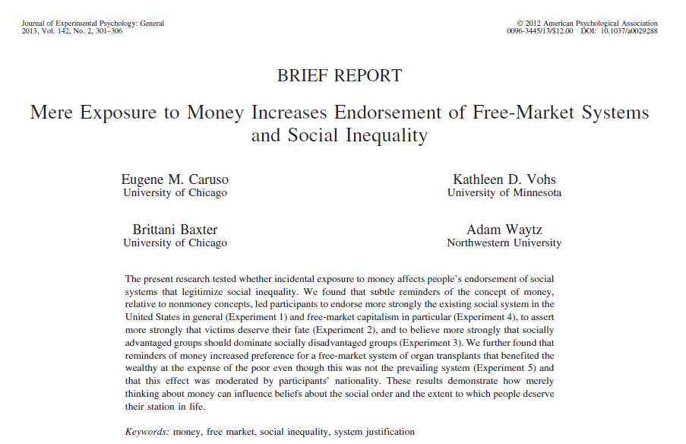

1. In general, you find society to be fair.
2. In general, the American political system operates as it should.
3. American society needs to be radically restructured.
4. The USA is the best country in the world to live in.
5. Most policies serve the greater good.
6. Everyone has a fair shot at wealth and happiness.
7. Our society is getting worse every year.
8. Society is set up so that people usually get what they deserve.

Slide 26
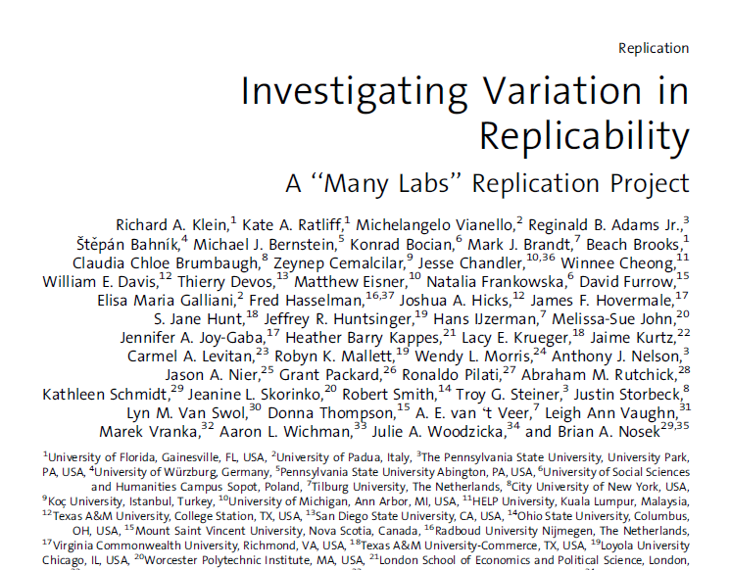
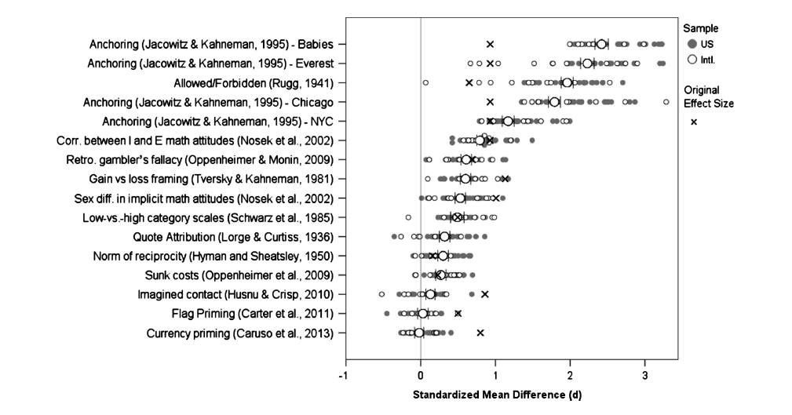

Slide 27
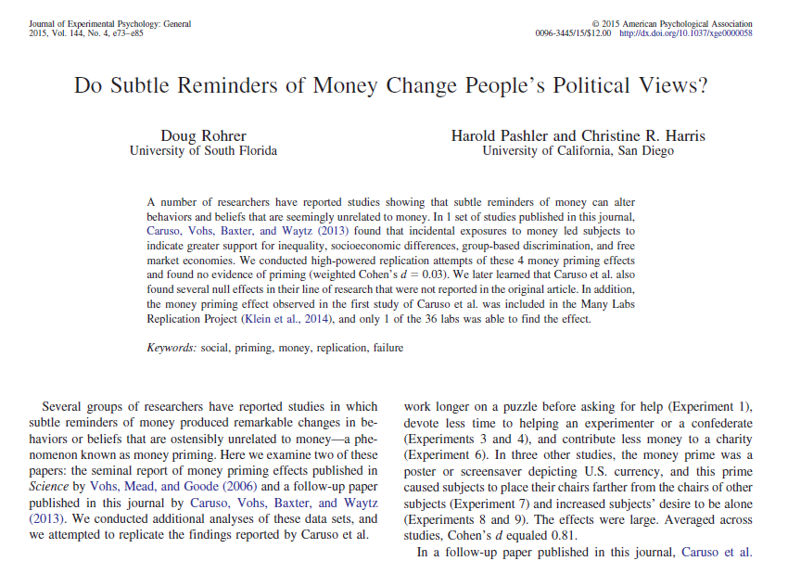

Slide 28
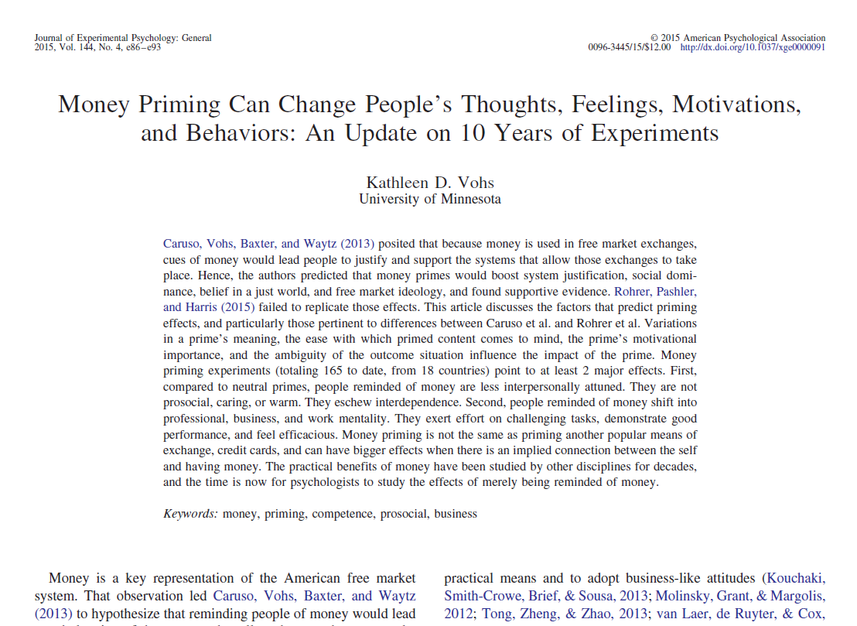
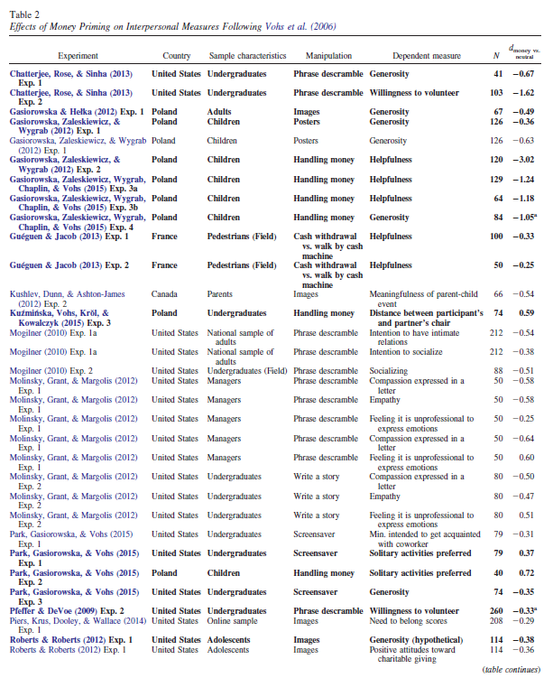
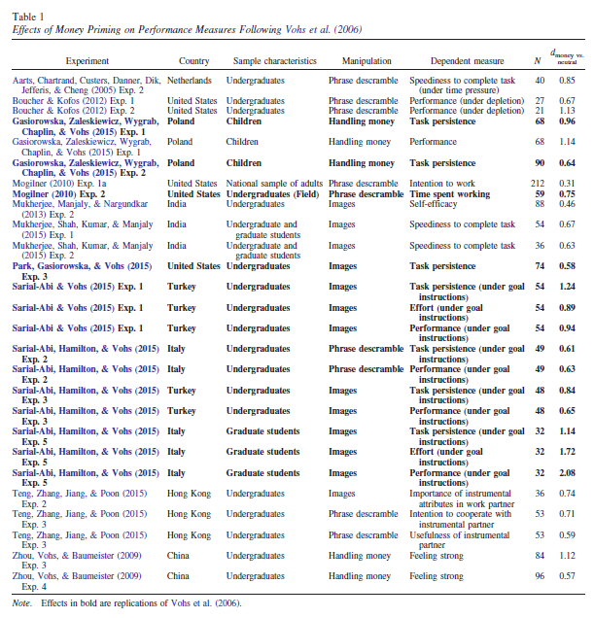
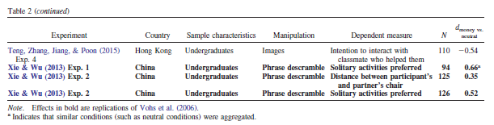

Slide 29
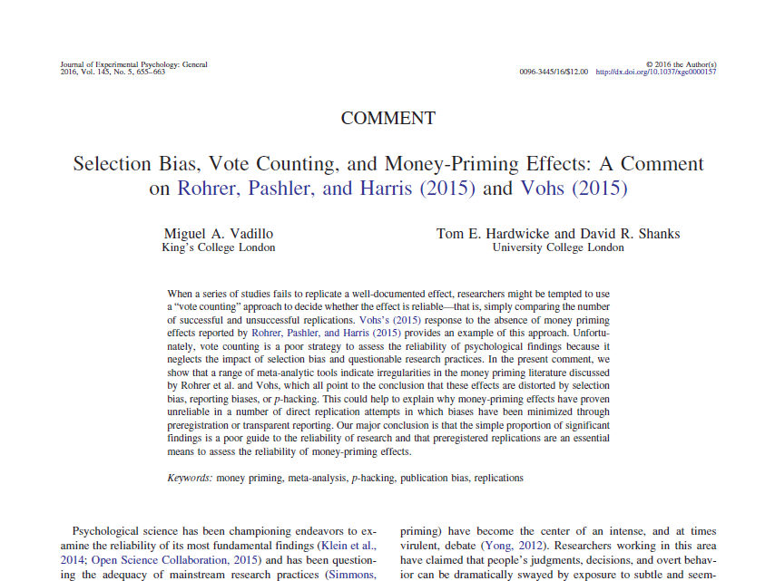
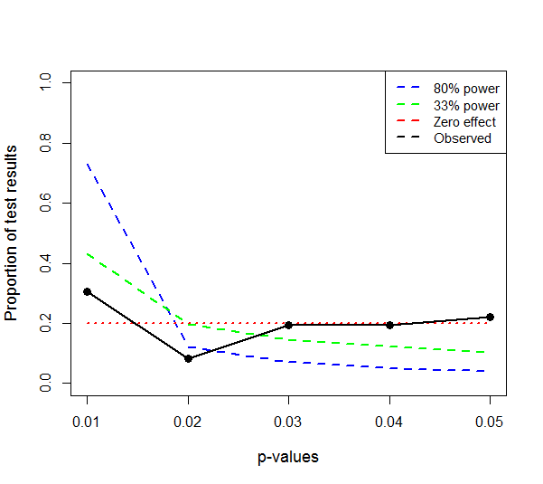

Slide 30
Do it yourself

Slide 31
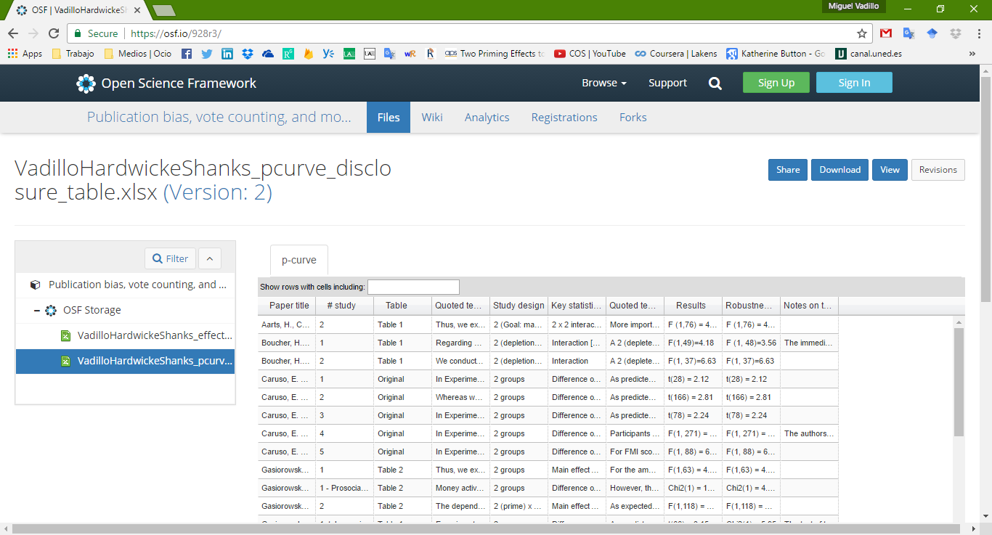
1. Download our data from the OSF https://osf.io/928r3/

Slide 32
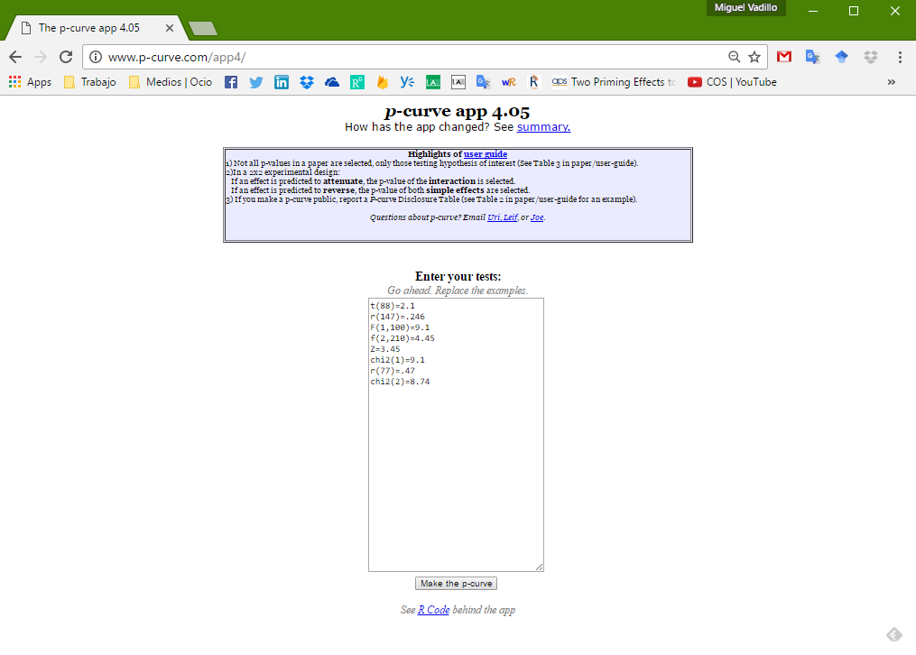
2. Go to the online p-curve app http://www.p-curve.com/app4/

Slide 33
3. Paste your data on the app and press the “make the p-curve” button

Slide 34
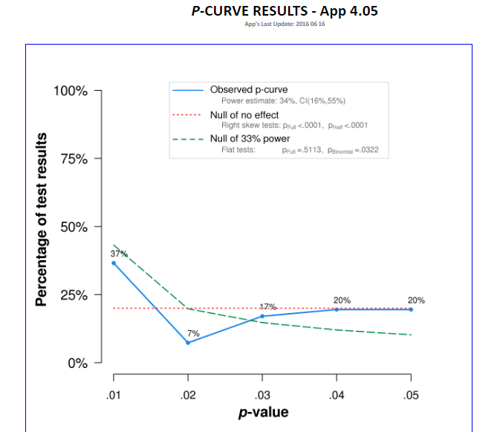
4. See the p-curve

Slide 35
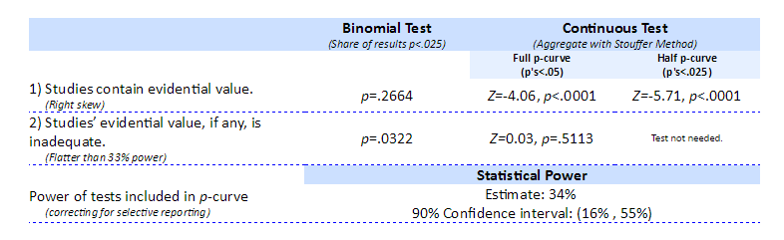
5. See the stats

Slide 36
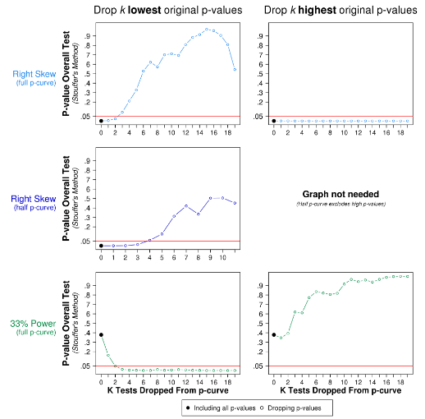
6. Do the results depend heavily on outliers?

Slide 37
Another example

Slide 38
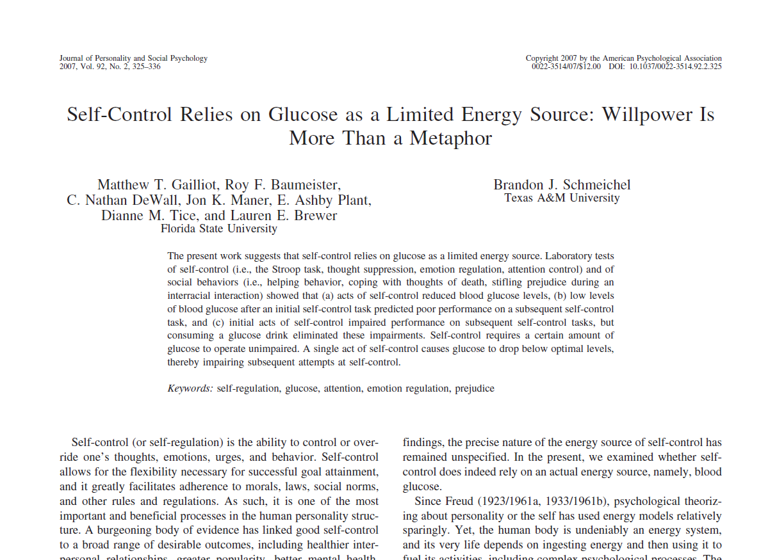

Slide 39
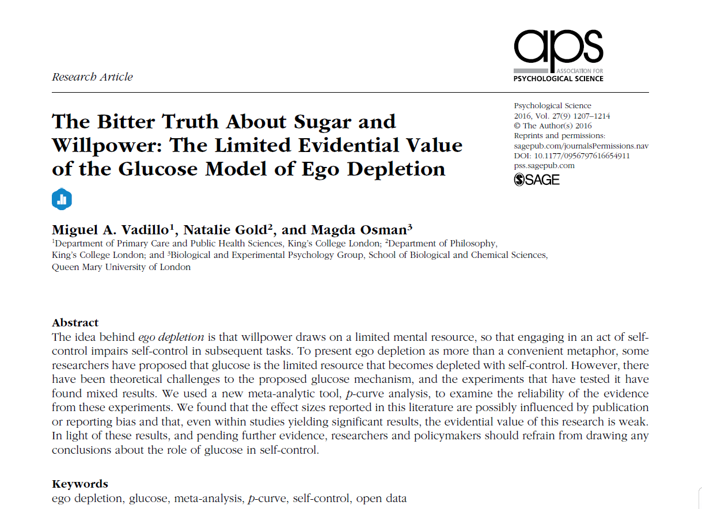
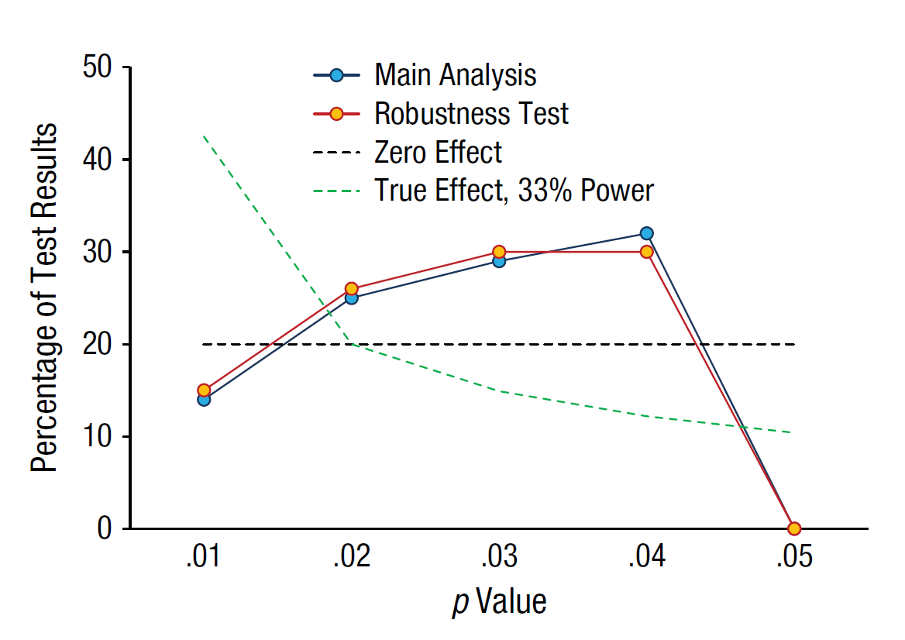

Slide 40
Do it yourself… again!

Slide 41
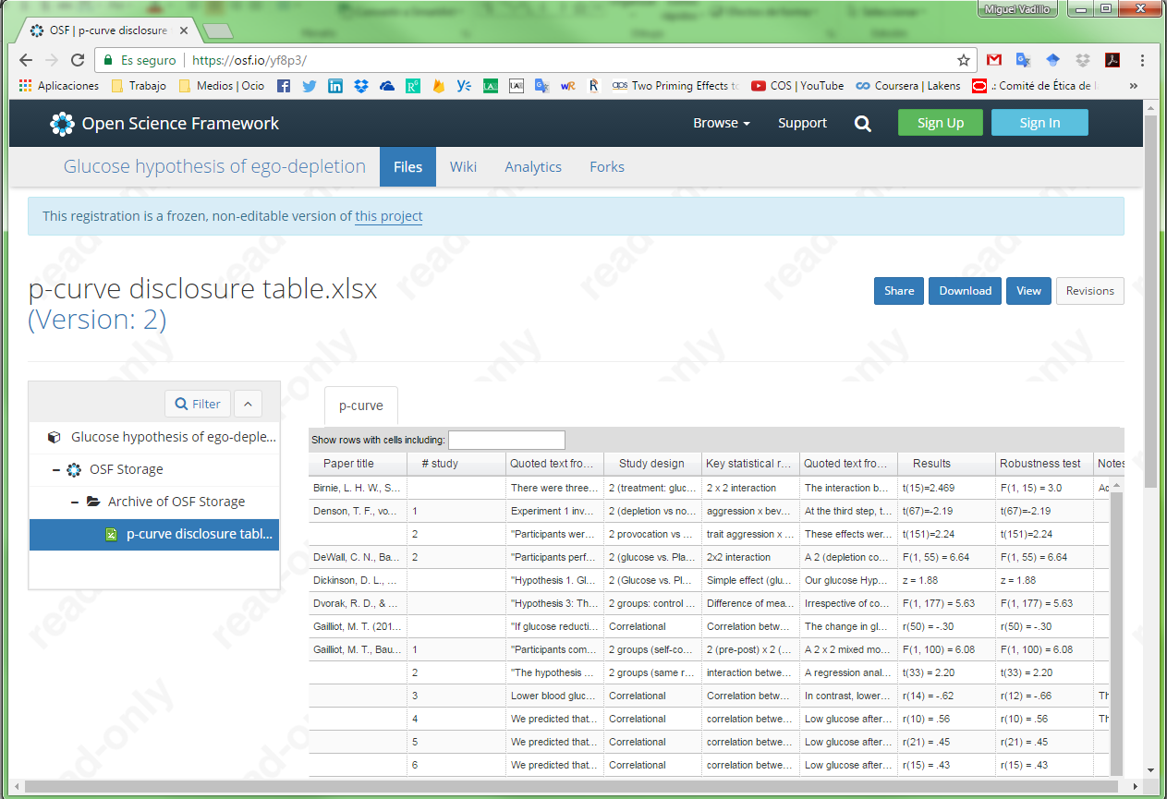
Download our data from the OSF https://osf.io/yf8p3/

Slide 42
Now on your own…

Slide 43
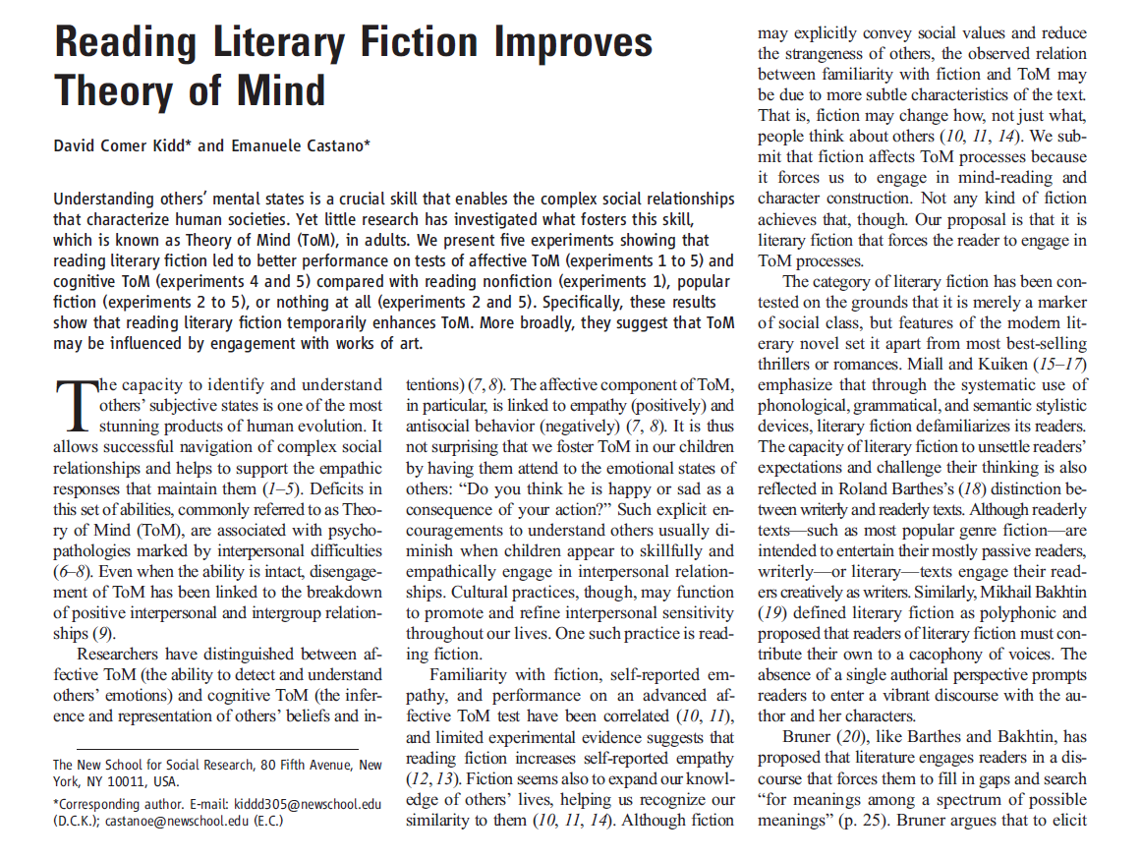
Available at
http://bit.ly/2ibp9Ip

Slide 44
Before you start using p-curve…

Slide 45
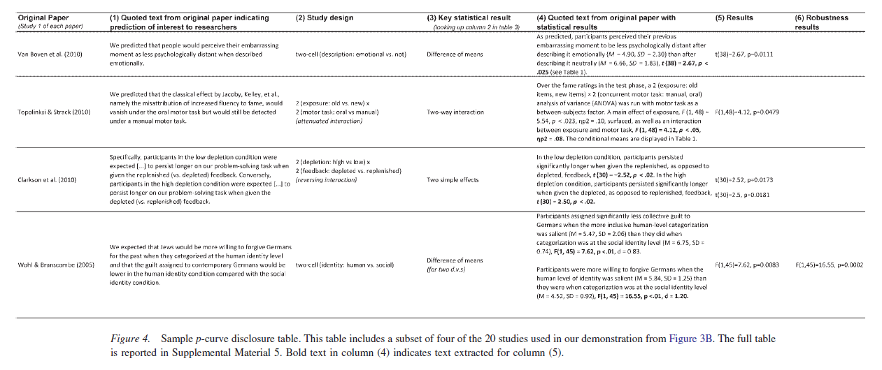
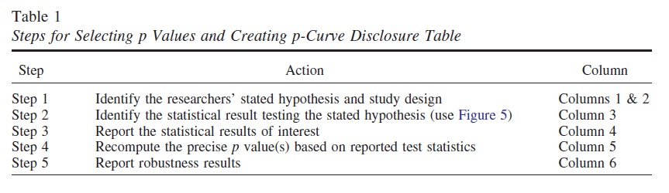
Prepare a p-curve disclosure table
(see Simonsohn et al., 2014, Figure 4 and Table 1)

Slide 46
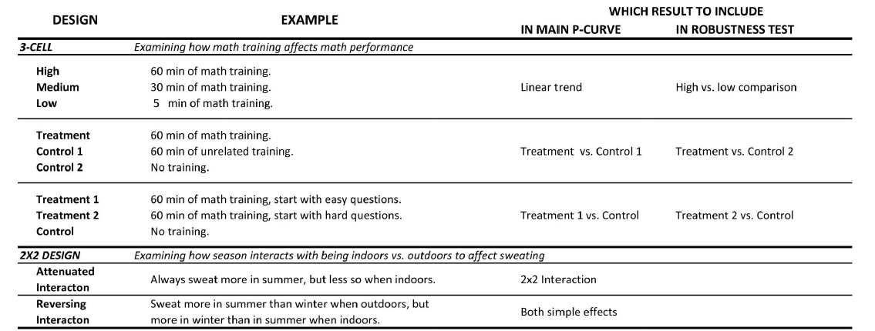
Select the key statistical contrasts
(it is not always easy; see Simonsohn et al., 2014, Figure 5)

Slide 47
Lessons learned so far:
1. You can’t believe everything you read in a paper
2. Beware of p-values larger than .04...
3. … especially if sample sizes are large.

Slide 48
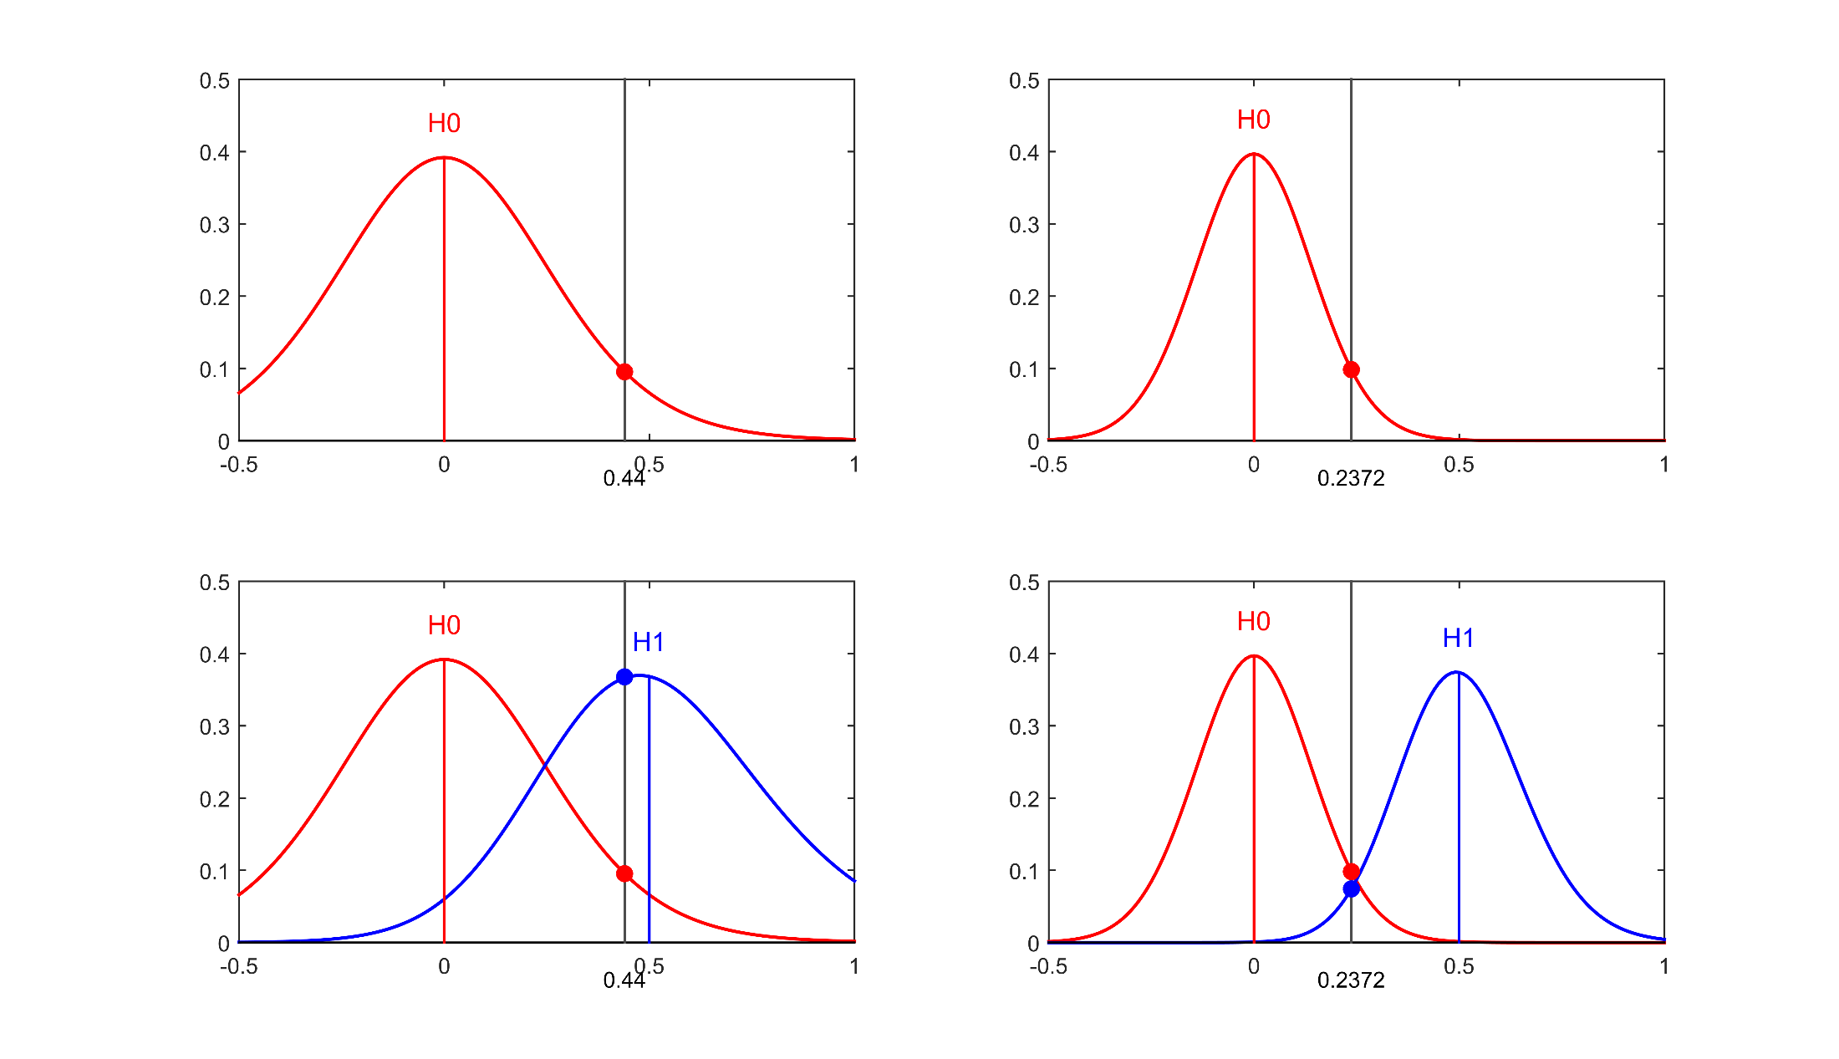
p = .05, N = 15
p = .05, N = 50
With a large simple, p = .05 is more likely under the null hypothesis.

Slide 49
Methods to detect biases in research
#2. Funnel plots

Slide 50
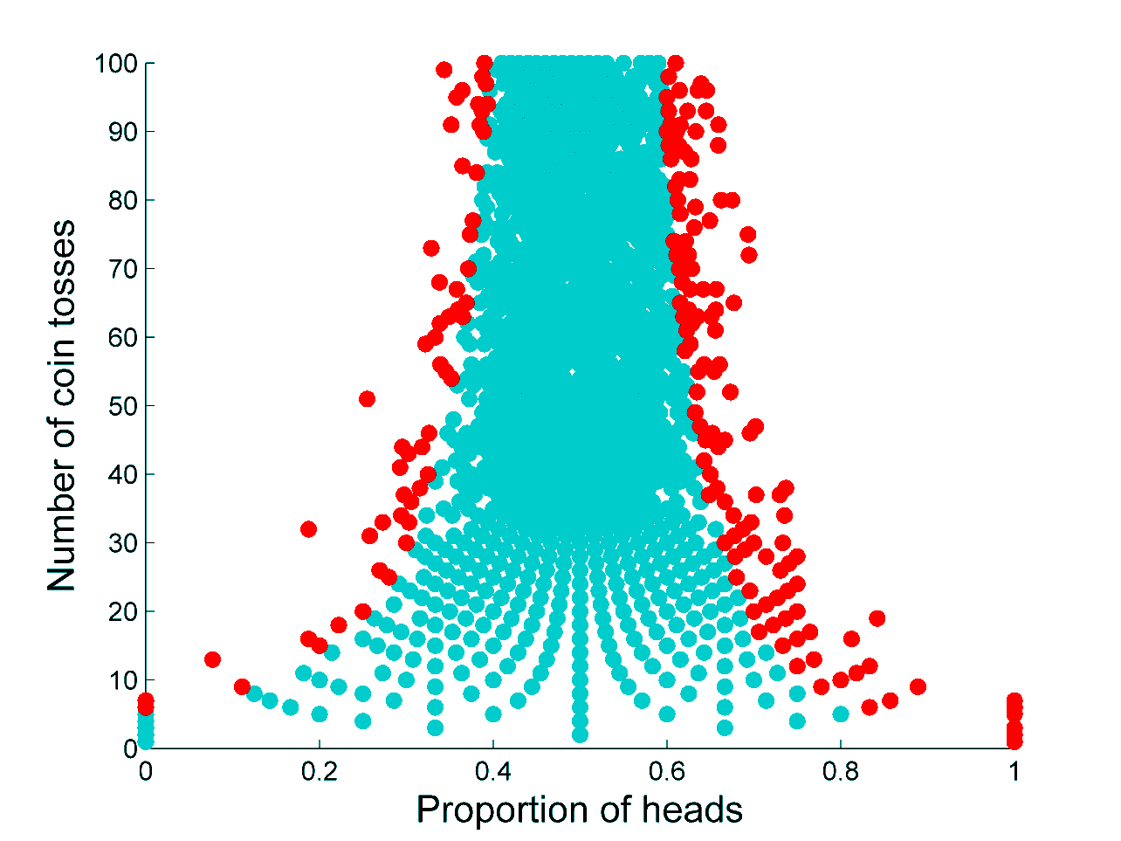
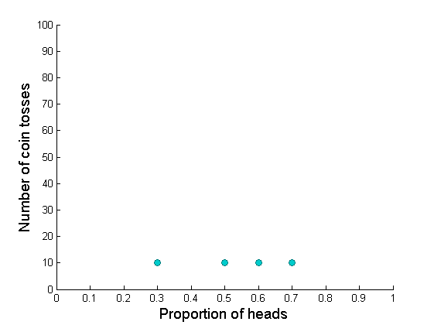



Slide 51





Slide 52
An example

Slide 53




Which of these three women do you find more attractive?
Imagine that you had a date with her.
What would your first date be like?

Slide 54



How much would you be willing to
spend in each of these products?

Slide 55


Slide 57



Slide 58
How can you do this?
It helps if you know the basics of meta-analysis…
1. How to compute effect sizes
2. How to compute the variance of effect sizes
3. How to use software for meta-analysis

Slide 59

1. How to compute effect sizes?

Slide 60



1. How to compute effect sizes?
Two independent groups
One sample t-test
Careful if there are within- and between-participants studies in the same meta-analysis!

Slide 61
2. How to compute the variance of effect sizes?
Two independent groups
One sample t-test
n₁ + n₂
-----------
n₁ · n₂
d²
-------------
2(n₁ + n₂)
1
-----
n
d²
-----
2n
V_{d} =
+
V_{d} =
+

Slide 62
3. How to use software for meta-analysis?
Download R: https://cran.r-project.org/bin/windows/base/
Download RStudio : https://www.rstudio.com/products/rstudio/download/
‘metafor’ package: https://cran.r-project.org/web/packages/metafor/metafor.pdf

Slide 63
3. How to use software for meta-analysis?
# install ‘metafor’ library
install.packages(“metafor”)
# load library
library(metafor)
# enter effect sizes
d<- c(0.38, 0.41, -0.14, 0.63, 0.22)
# enter sample sizes
n1 <- c(75, 48, 22, 18, 60)
n2 <- c(75, 52, 21, 20, 55)
# compute variances
d.v <- (((n1+n2)/(n1*n2))+(d^2/(2*(n1+n2))))
# run meta-analysis
meta <- rma(d, d.v)
# see the results of the meta-analysis
meta
Adapted from Lakens
https://gist.github.com/Lakens/e6b81b7241e3019b12d3

Slide 64


Slide 65

forest(meta)
It returns a forest plot with the confidence intervals of the effect sizes in each study and the CI of the meta-analytic average

Slide 66

funnel(meta)
It plots effect sizes against their standard error. Ideally, they should follow a funnel-shaped distribution.

Slide 67

regtest(meta)
Is there any evidence of correlation between effect size and standard error? A significant correlation is suggestive of bias.

Slide 68
Do it yourself

Slide 69



Slide 70

Download our data from the OSF https://osf.io/awxn2/
d = effect size, vi = variance of the effect size

Slide 71
# simplified code:
# you need to convert the data file in https://osf.io/awxn2/ to .csv format.
# rename the file as “romantic.csv” and put it on R’s working directory
# load library
library(metafor)
# read data from spreadsheet
data <- read.csv("romantic.csv")
# save effect sizes and variances in variables d and d.v
d <- data$d
d.v <- data$vi
# run meta-analysis and plot
meta <- rma(d, d.v)
funnel(meta, refline=0)

Slide 72
Another example

Slide 73


Slide 74

Download our data from the OSF https://osf.io/9n2wh/
Do the funnel plot only for studies labeled as “Original”, “Table 1” and “Table 2”. In this case you have to compute the variances from sample sizes (Ns) and Cohen’s d.

Slide 75
# simplified code:
# you need to convert the data file in https://osf.io/9n2wh/ to .csv format.
# rename the file as “money.csv” and put it on your working directory
# load library
library(metafor)
# read data from spreadsheet
data <- read.csv("money.csv")
data <- subset(data, Table=="Original") # only "original” studies
# save effect sizes and sample sizes, and compute variances
d <- data$d
n1 <- data$Nexp
n2 <- data$Ncon
d.v <- ((n1+n2) / (n1*n2)) + ((d^2) / (2*(n1+n2)))
# run meta-analysis and plot
meta <- rma(d, d.v)
funnel(meta, refline=0)

Slide 76
Lessons learned so far:
1. You can’t believe everything you read in a paper
2. Beware of p-values larger than .04...
3. … especially if sample sizes are large.
4. Careful if small studies yield large effects…
5. … especially if they are very large!

Slide 77



Slide 78



Slide 79



Slide 80
Methods to detect biases in research
#3. Test for excess significance

Slide 81


Slide 82


Slide 83



Slide 84


Slide 85
# load meta and pwr packages
library(meta)
library(pwr)
# enter effect sizes, sample sizes
d<- c(0.8, 0.44, 0.51 , 0.4613, 0,5039)
n1 <- c(15, 84, 40, 138, 46)
n2 <- c(15, 84, 40, 137, 46)
# compute variances and standard errors
d.v <- ((n1+n2) / (n1*n2)) + ((d^2) / (2*(n1+n2)))
d.se <- sqrt(d.v)
# find number of significant and non-significant results
ci <- data.frame(ci(TE = d, seTE = d.se))
NumNonSig <- with(ci, c(sum(p>.05)))
NumSig <- length(d)-NumNonSig
# find mean observed power
Powers <- mapply(pwr.t2n.test, d=d, n1 = n1, n2 = n2)
ObsPowers <- sapply(Powers[5,1:length(d)], as.numeric)
MeanPower <- mean(ObsPowers)
# Compare observed power and number of significant findings
BinomPower <- mapply(binom.test, NumSig, length(d), MeanPower, conf.level = .90, alternative = "greater")
p.value <- sapply(BinomPower[3], as.numeric)
Adapted from Carter & McCullough
http://journal.frontiersin.org/article/10.3389/fpsyg.2014.00823/full

Slide 86
Lessons learned so far:
1. You can’t believe everything you read in a paper
2. Beware of p-values larger than .04...
3. … especially if sample sizes are large.
4. Careful if small studies yield large effects…
5. … especially if they are very large!
6. Do not trust papers containing only significant results, unless their power is very large.

Slide 87

A fantastic website to put this (and more!) in practice http://shinyapps.org/apps/p-checker/

Slide 88
For the times they are a-changin’

Slide 89


Slide 90


Slide 91
To learn more…
Bakker, M., van Dijk, A., & Wicherts, J. M. (2012). The rules of the game called psychological science. Perspectives on Psychological Science, 7, 543-554.
Carter, E. C., & McCullough, M. E. (2014). Publication bias and the limited strength model of self-control: Has the evidence for ego depletion been overestimated? Frontiers in Psychology, 5, 823.
Ioannidis, J. P. A. (2012). Why science is not necessarily self-correcting. Perspectives on Psychological Science, 7, 645-654.
Munafò, M. R., Nosek, B. A., Bishop, D. V. M., Button, K. S., Chambers, C. D., Percie du Sert, N., Simosohn, U., Wagenmakers, E.-J., Ware, J. J., & Ioannidis, J. P. A. (2017). A manifesto for reproducible science. Nature Human Behaviour, 1, 0021.
Wagenmakers, E.-J., Wetzels, R., Borsboom, D., van der Maas, H. L. J., & Kievit, R. A. (2012). An agenda for purely confirmatory research. Perspectives on Psychological Science, 7, 632-638.

